Slide 1
Predicting Air Quality Levels using PM2.5 and weather Data
By :Tirumala Teja Yegineni
Date: 4/28/2025
Course: Discovery and Learning with Big Data
Under the guidance of
Prof. Dr. Shon Williams

Slide 2
Problem Statement
The objective is to predict the daily air quality levels in a area in Los angels county based on past pm2.5 pollution data and weather information.
1
Need for a more rapid and more scalable approach for forecasting than the traditional methods.
2
Accurate classification will result in timely public health alerts and better urban environmental management.
3

Slide 3
Business Understanding
PM2.5 air quality forecasting is necessary in order to safeguard public health in urban areas.
Similar forecasting is also carried out by other big organizations like the EPA, NOAA, and private agencies.
This project creates a light, accurate machine learning model that forecasts air quality into actionable ranges based on past pm2.5 pollution and weather data.

Slide 4
Introduction
PM2.5 stands for the Particulate matter that is 2.5 micrometers or smaller in diameter. This means the particles are 30 times smaller than the hair of the human.
These particles are made up of the dust , smoke, liquid droplets etc.
If PM2.5 presents in the air it can penetrate deep into the lungs and if there is possibility it can enter into the bloodstream too causing unhealthy conditions like asthma, heart disease and respiratory infections.
So it is mainly dependent on the weather conditions. So we are taking temperature, precipitation, visibility and pm2.5 daily data as features to predict the air quality.

Slide 5
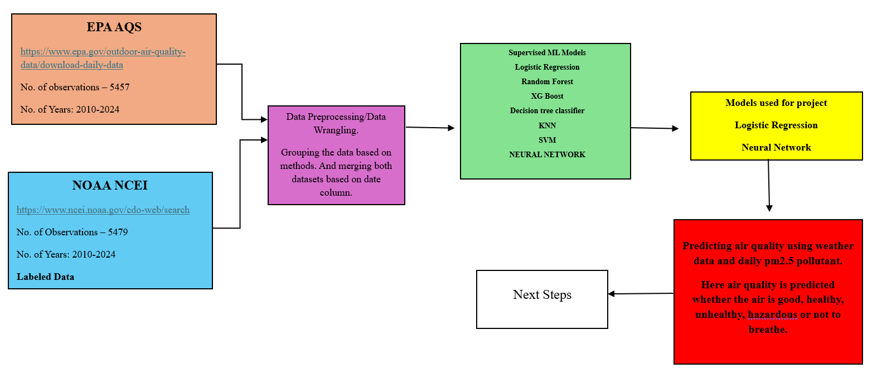
Project Architecture
a

Slide 6
Datasets Information
I have taken PM2.5 daily values from the Environmental Protection Agency Air Quality System (EPA AQS). And it contains data from 2010 to 2024. And there are 12967 rows and 22 columns in this dataset.
And the weather data is collected from the National Oceanic and Atmospheric Administration National Centers for Environmental Information (NOAA NCEI). This data is also from 2010 to 2014. And there are 5479 rows and 28 columns.
I have taken pm2.5 daily data from Los Angeles North Main street. And the weather data from Los angels international airport. Where both the areas are very close within 20miles. So pm2.5 and the weather doesn’t vary much around this region.

Slide 7
S.NO | Feature Name | Data Type | Description | Units
1) | PM2.5 | Numeric | Actual daily pm2.5 concentration | µg/m³
2) | TEMP_C | Numeric | Average daily air temperature | C
3) | PRCP_MM | Numeric | Daily total precipitation | Millimeters(mm)
4) | WDSP_MS | Numeric | Average daily windspeed | Meters per second(m/s)
5) | VISIB | Numeric | Average daily horizontal visibility | Kilometers(km)
6) | RH | Numeric | Average daily relative humidity | Percentage(%)
7) | PM2.5_lag1 | Numeric | PM2.5 value 1 day before | µg/m³
8) | PM2.5_lag2 | Numeric | PM2.5 value 2 days before | µg/m³
9) | PM2.5_lag3 | Numeric | PM2.5 value 3 days before | µg/m³
10) | PM2.5_roll3 | Numeric | 3 day rolling mean | µg/m³
11) | Temp_rh | Numeric | Product of temperature and relative humidity | C * %
12) | Wind_precip | Numeric | Product of windspeed and precipitation | m/s * mm
13) | Temp_vis | Numeric | Product of temperature and visibility | C * km
14) | Day_of_week | Categorical | Day of the week when measurement taken | (0-6)
15) | month | Categorical | Month number when measurement taken | (1-12)
16) | PM2.5_AQI | Categorical | Air Quality index category based on PM2.5 value. | Classes(0,1,2,3)
Target Variable: PM2.5_AQI Category(0=Good, 1= Moderate, 2=Unhealthy for sensitive groups, 3= Unhealthy, 4= Very Unhealthy/Hazardous

Slide 8
Data Preparation
The data is taken from the 2010 to 2024. I have downloaded the data for each year individually.
So the data is merged and made into one csv file. The EPA AQS data contains 12967rows. This means on the same date the values are measured by different instruments.
So I grouped and averaged the data in EPA file using the date column. After that it contains 5457 rows. And selected only pm2.5 daily data column. So EPA data now has 5457rows and 2 columns.
NOAA NCEI data is also from 2010 to 2024. Merged all the files and made into one csv file.
Merged both the datasets based on date column into one csv file. So final dataset has 5457 rows and 16 columns.
New features are created using existing features. And lagged features are created.
Data cleaning is done after creation of new features.
Labelled column is created based on pm2.5 values.

Slide 9
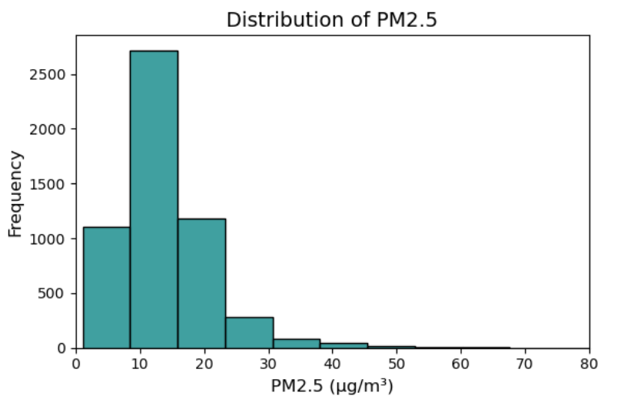
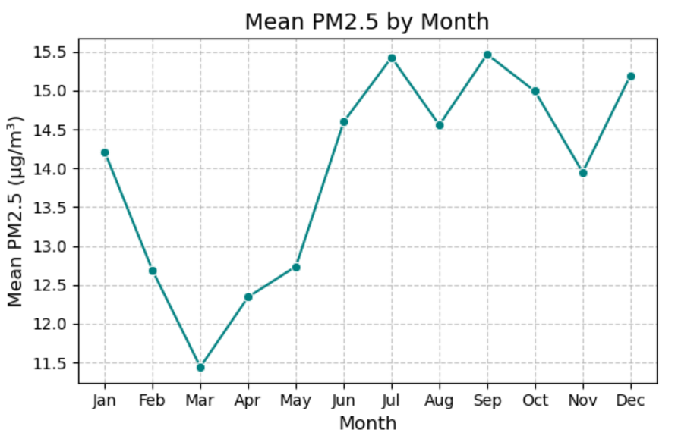
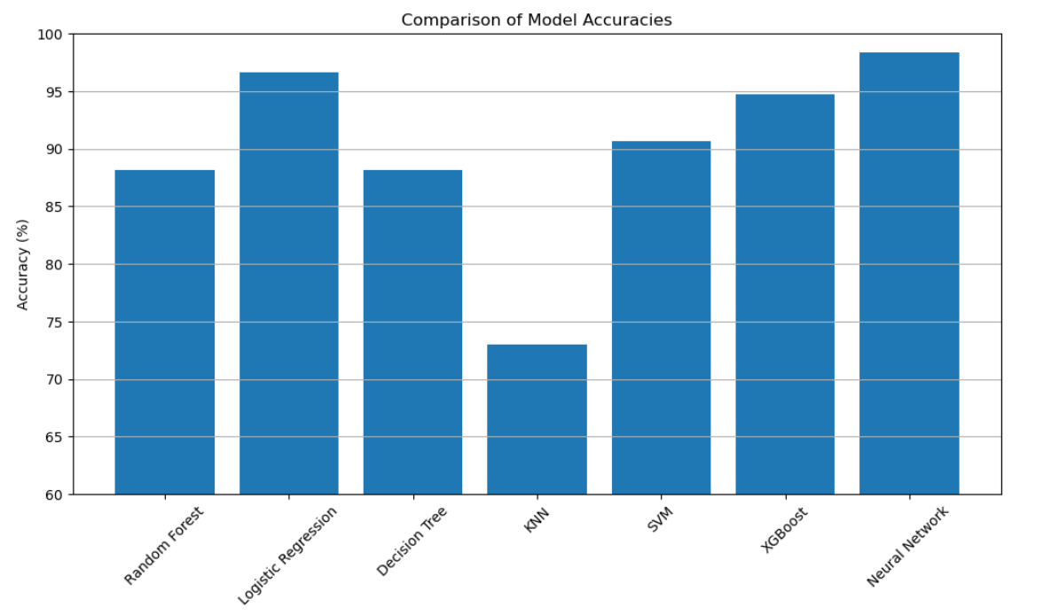
Visualizations

Slide 10
Algorithms
Logistic regression:
Logistic Regression provided a strong performance (96.61% accuracy) with a simple, interpretable model that was fast to train and effective, making it an excellent lightweight alternative despite slight struggles with very rare classes.
Neural Network:
The MLP Neural Network achieved the highest accuracy (97.8%), effectively capturing complex non-linear relationships and correctly predicting all AQI categories, including rare ones. Its deep learning architecture made it the most robust and reliable model for PM2.5 classification.

Slide 11
Conclusion
This project has shown that it is feasible to utilize machine learning models, namely MLP Neural Networks and Logistic Regression, to forecast PM2.5 AQI levels for one area in Los Angeles County based on historical weather and pollution data.
The addition of lagged PM2.5 terms, meteorological variables, and designed interactions significantly enhanced model performance.
This approach may be expanded to include real-time air quality forecasting, early public health alerts, and environmental policymaking.

Slide 12

Q&A Session
Question & Answers Session

Slide 13

Thank you

